Slide 1
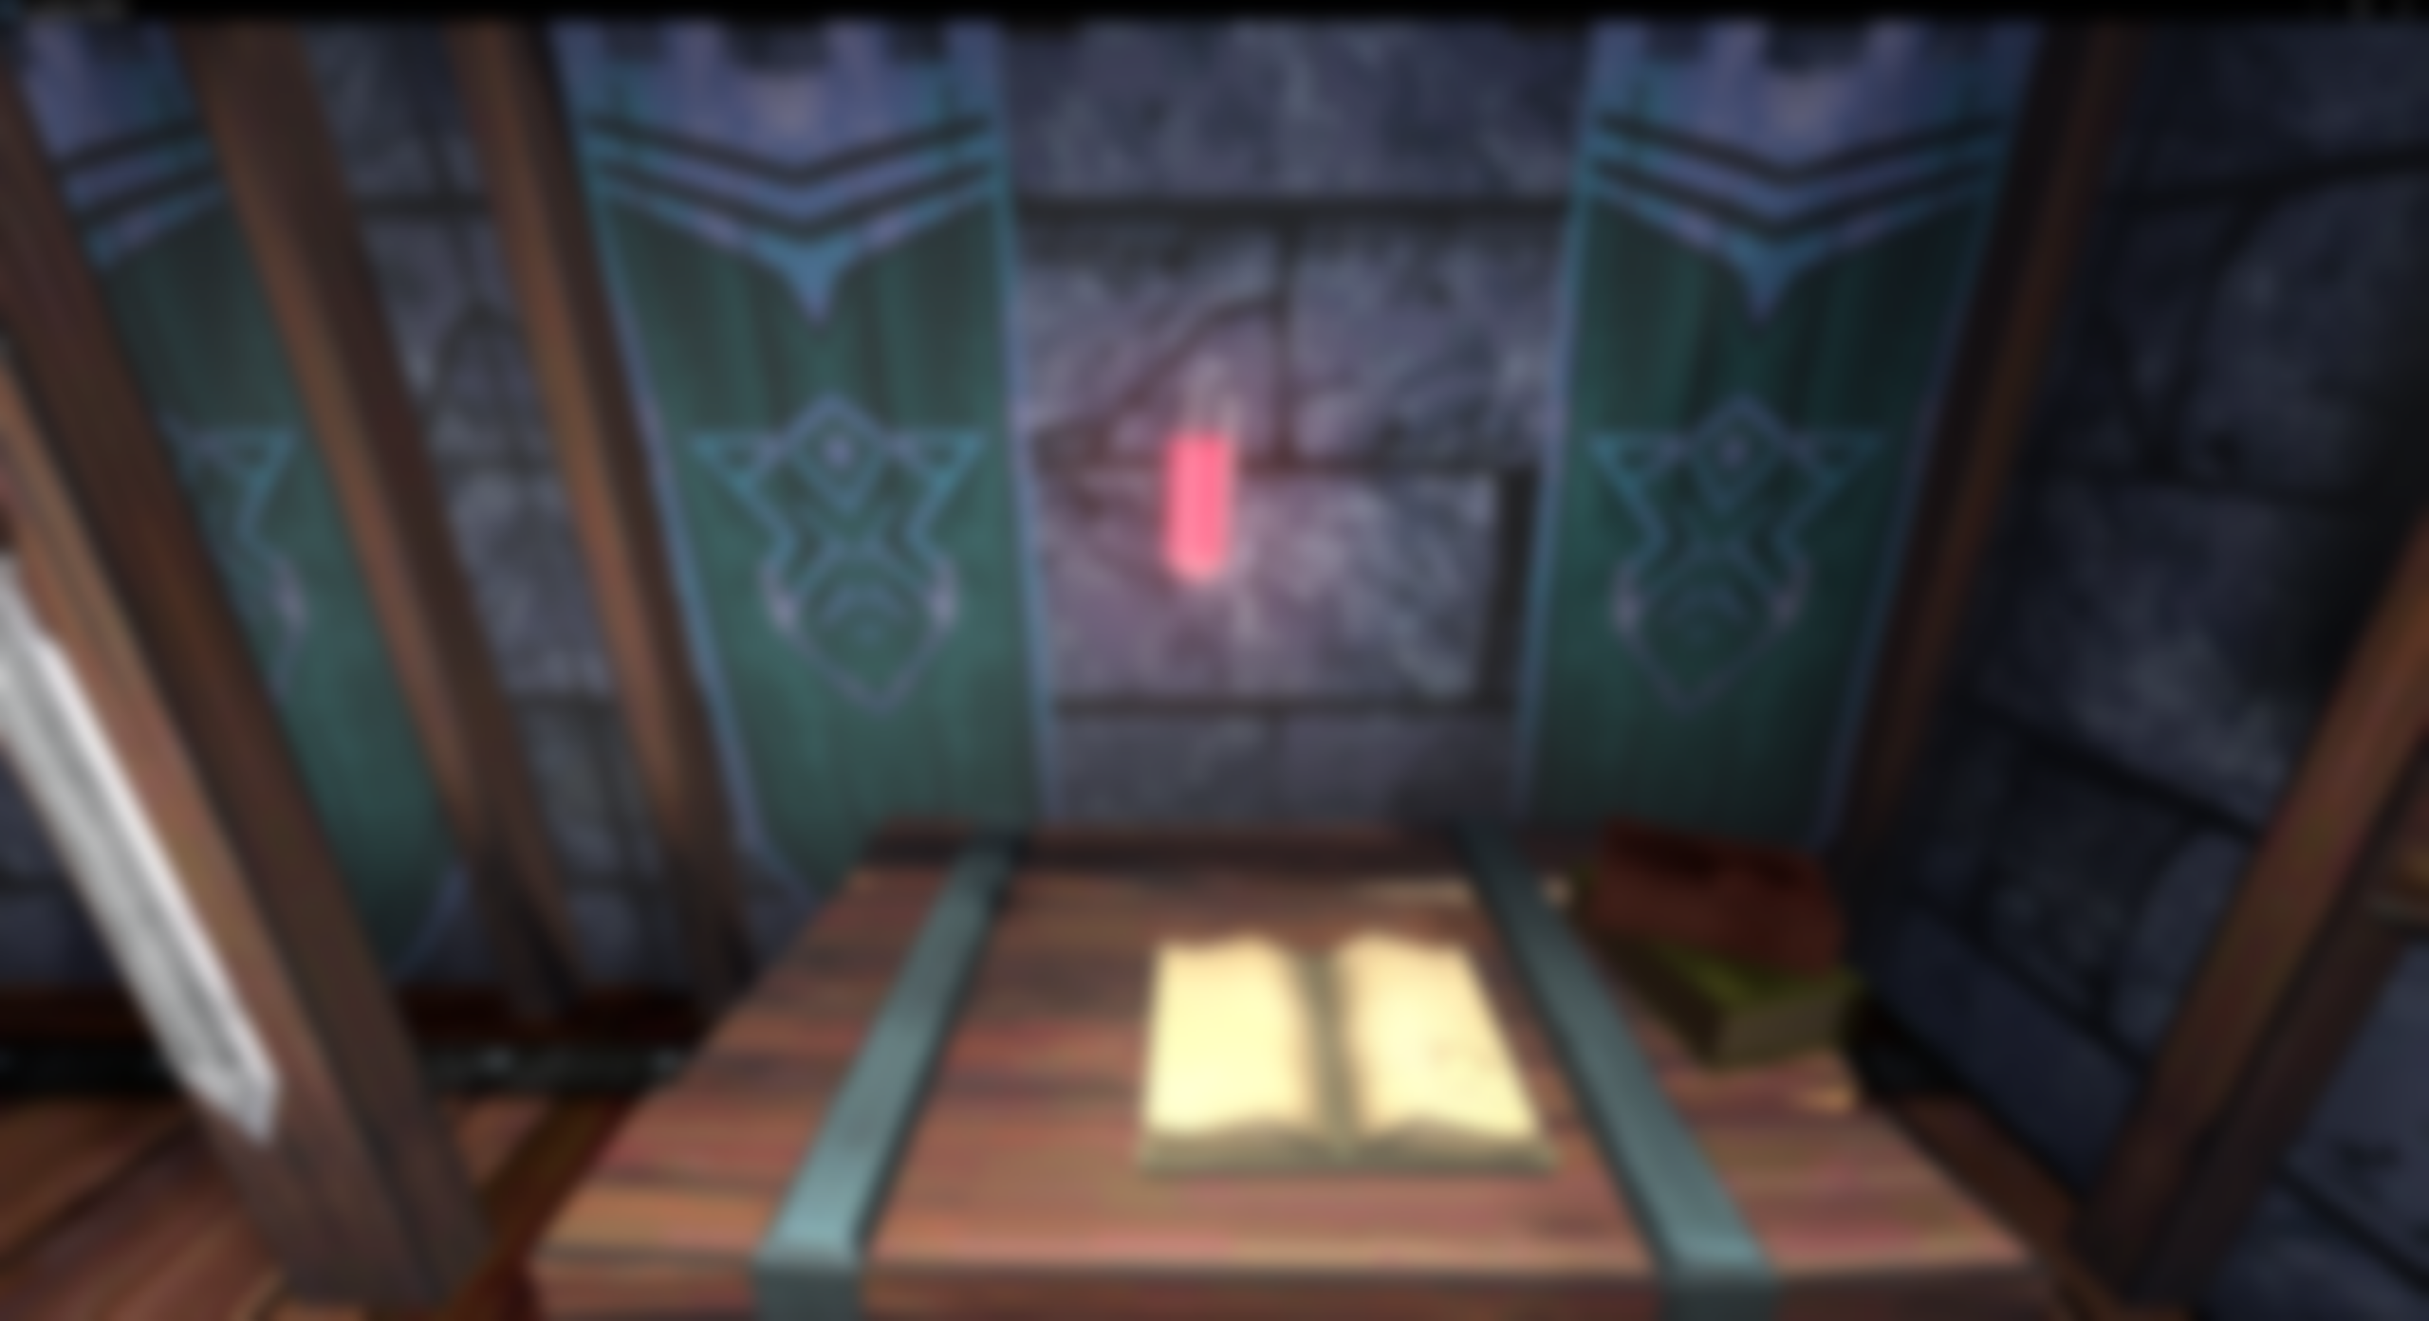
Liquid Bottle Shader in Godot 4
Lycia Stenson

Slide 2
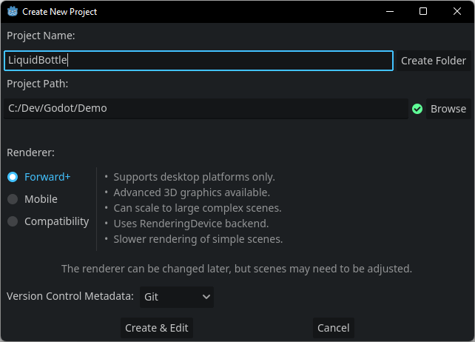
Creating a Project in Godot
Project Path - Navigate to the folder within which you will save your project
Create Folder will create a folder here with the name of your project

Slide 3
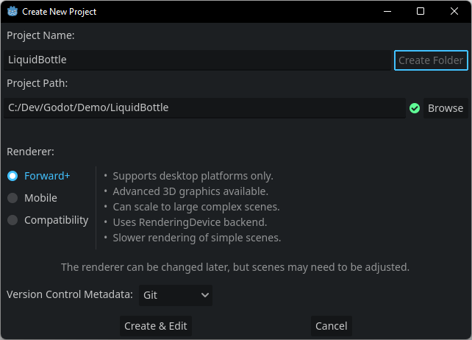
Creating a Project in Godot
Project Path - Navigate to the folder within which you will save your project
Create Folder will create a folder here with the name of your project

Slide 4
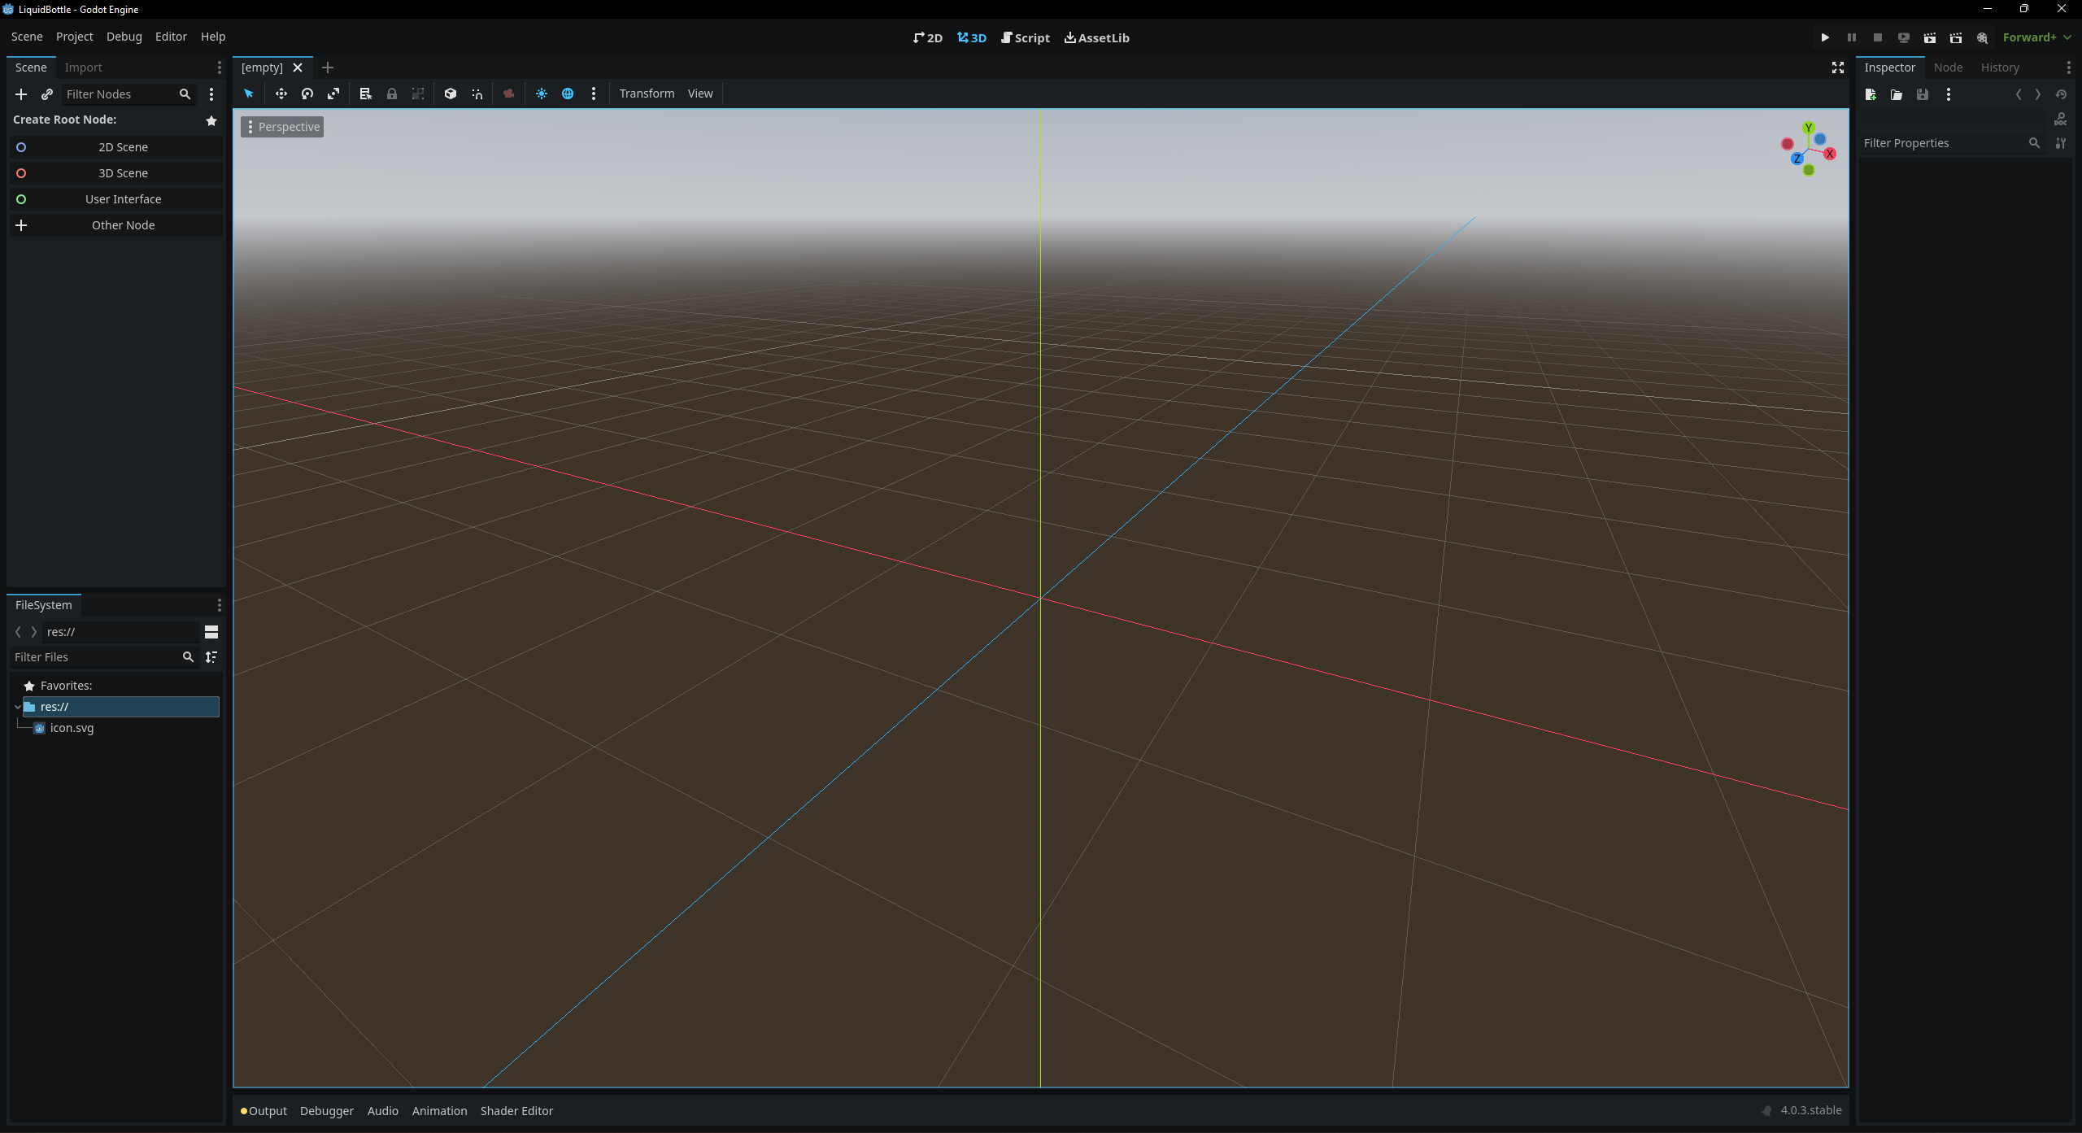

Slide 5
What you need to know about scenes in Godot
Unity has Scenes and Prefabs. Unreal has Scenes and Blueprint/C++ Classes.
However, Godot makes no distinction between scenes and objects within the scene.
They are all Scenes, made up of sub-objects called Nodes.
Levels, players, and other objects in Godot are all scenes
These can be saved as .tscn or .scn files (t refers to text, instead of binary) and placed within other scenes as part of the Node hierarchy.

Slide 6
Creating the Bottle Scene

Slide 7
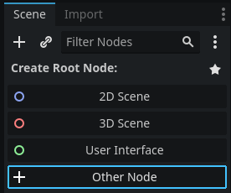
Creating the Bottle Scene
To create a Scene, we need to choose the typo of its root node
In the Scene Panel, click + Other Node and search for RigidBody3D

Slide 8
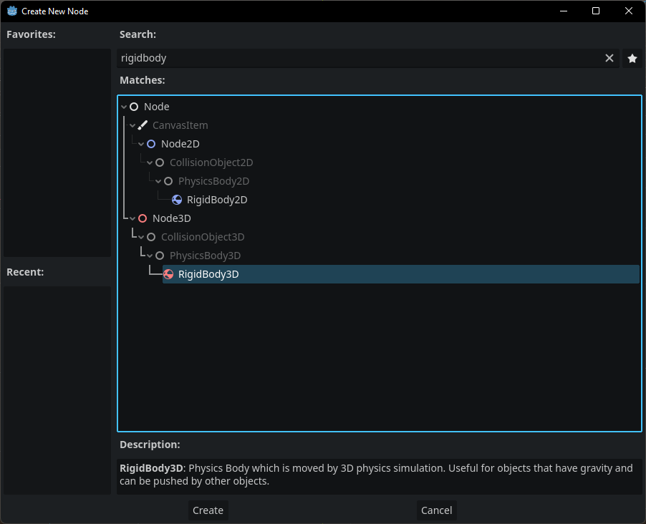
Creating the Bottle Scene
To create a Scene, we need to choose the typo of its root node
In the Scene Panel, click + Other Node and search for RigidBody3D

Slide 9
Adding Child Nodes

Slide 10
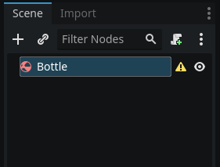
Adding Child Nodes
The root node can be renamed to indicate the contents of the Scene
As well as the RigidBody3D, the bottle needs a CollisionShape3D and MeshInstance3D
The CollisionShape3D must be a direct child of the RigidBody3D
The MeshInstance3D must be a child of the RigidBody3D for the mesh to move with the rigid body

Slide 11
Creating the Bottle Script
Start with basic drag movement script

Slide 12
Creating the Shaders and Materials

Slide 13
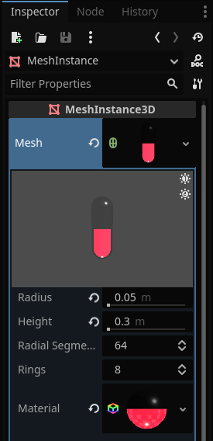
Creating the Shaders and Materials
The bottle has three materials
A Standard Material for the glass
A second pass for the liquid
A third pass for the liquid surface

Slide 14
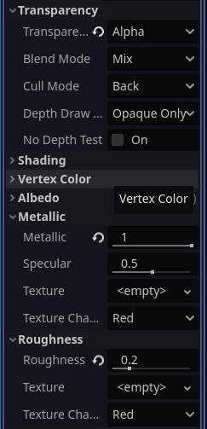
Glass Material
Enable Transparency and set the Albedo to a transparent grey
Set values for Metallic and Roughness

Slide 15
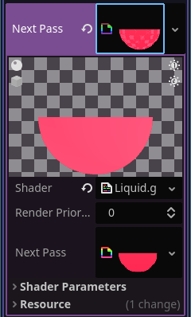
Liquid Shader
Create a new ShaderMaterial in the Next Pass and create a new .gdshader file in Shader

Slide 16
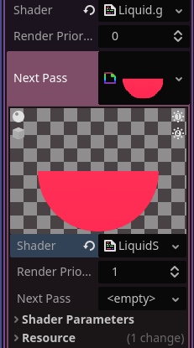
Liquid Surface Shader
Create a new ShaderMaterial in the Next Pass and create a new .gdshader file in Shader
The Surface Shader is mostly the same as the Liquid Shader but instead of culling back we cull front, and updating NORMAL to give the appearance of a surface

Slide 17
Adding Liquid ‘Physics’

